Slide 1
Is the goal you can read the goal that steers the robot?
RESEARCH PILOT · ROBOT INTERPRETABILITY
Reading and editing a robot model’s internal “plate” / “stove” goal, and checking where the bowl actually lands
Keahi Xie · Rutgers ECE
Notes:
Hi, I’m Keahi. My project asks a simple question about robot AI models: if you can read the robot’s goal inside the model, is that the part that actually decides where the robot goes?

Slide 2
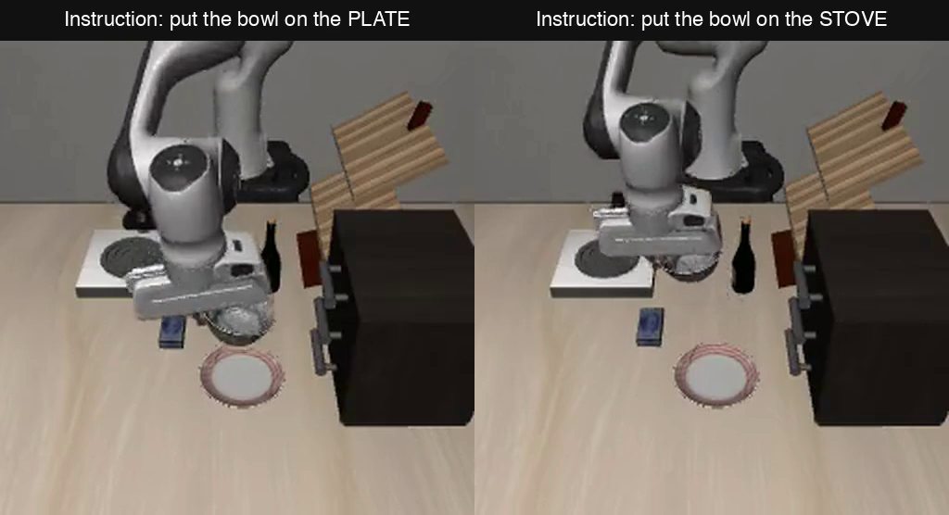

What is a VLA? (vision-language-action)
Camera image + instruction
“Put the bowl on the plate”
VLA model
An AI that sees and reads, trained on robot demos
Arm movements
Many small moves per second
Same scene, two instructions (LIBERO simulator)
Research area: interpretability. Look inside these models to see what they “think”, and edit it to change what the robot does.
Notes:
A VLA, a vision-language-action model, is the new kind of robot AI. It takes a camera image and an instruction in plain words, and outputs arm movements, several times a second. It’s built from the same kind of AI as chatbots, then trained on robot demonstrations. The video shows one doing my task in a simulator: same scene, told plate or stove. My research area is interpretability: looking inside these models to read what they’re thinking, and editing it to change what the robot does.

Slide 3
Closest prior work: the goal you read didn’t steer
“When Language and Action Diverge: Observing Recurrent Memory in a Hybrid VLA” · ACL ARR 2026, under review
Robot: Galaxea G0.5, two arms (left vs right) · Lens: J-lens; the logit lens gave the same results
Test 1 · Edit the plan they could read
Test 2 · Split the edit in two
45/51
0/35
1/36
35/36
the plan it wrote changed
switched to the other arm
readable part steered
hidden part steered
(11 of 35 just stopped)
Their explanation
What’s still open
G0.5 has extra memory layers that carry the goal forward, so the split may come from them.
Does the split show up in a plain model with no memory layers, with the robot actually moving?
Notes:
The closest work to mine is a paper currently under review at ACL Rolling Review, called “When Language and Action Diverge.” They study a robot model called G0.5, which has two arms and writes out a plan in words, like “move left gripper,” before it moves. Their main reading tool is the J-lens, an upgraded logit lens: instead of reading a middle layer as if it were the last one, it first translates the middle layer into last-layer form, then reads it. They report the plain logit lens, the one I use, gave the same readability and similar swap counts. They read the left-or-right goal inside the model, then edited it. Test one: editing the plan they could read changed the plan the robot wrote 45 out of 51 times, but switched the reach to the other arm 0 out of 35 times; in 11 of them the arm just stopped. The tasks are two-arm household tasks from real robot recordings, like “Fully open the paper cover on the wall with your right hand,” one saved moment each, and they only look at the moves the model predicts from that moment. Test two: they split the edit into the part the lens can read and the hidden rest. The readable part steered the arm 1 time out of 36; the hidden part steered it 35 out of 36. The readable part was only 1 to 5 percent of the change, close to the 5 percent I see in my model. Their explanation is that G0.5 has extra memory layers that carry the goal, so the split might come from those. What’s still open is whether this happens in a plain model with no memory layers, and with the robot actually moving in the simulator. That’s what I test.

Slide 4



My approach: read and edit the goal inside
Read: “plate” or “stove”? (logit lens)
Image +
188 tokens
32 layers
Word scorer
Numbers
“bowl on plate”
960 numbers each
where we probe
picks next token
→ arm moves
Edit: paste in the “stove” version
 | G0.5 paper | My pilot
Robot model | G0.5: two arms, writes a plan first | VLA-0-Smol (0.5B): one arm, no plan
Inside | attention + memory layers | attention only (32 layers)
Goal read | which arm: left or right | where the bowl goes: plate or stove
Lens | J-lens (logit lens: same result) | logit lens
Checked by | recorded photos only; robot never moved | recorded photos + simulator: bowl really lands
Notes:
Here’s the model inside. The picture and the instruction become 188 tokens, each a list of 960 numbers. They pass through 32 layers, then a word scorer picks the next token, and the model types out the arm moves as numbers. At a middle layer I do two things. Read: use the logit lens to see whether it holds plate or stove. Edit: paste in the stove version of its internal notes and see if the arm follows. The table shows how this differs from the G0.5 paper. Their robot has two arms and writes a plan in words before it moves; mine has one arm and just types its moves. Theirs has extra memory layers, which they think cause the split; mine has only attention layers, so if the split still shows up, memory isn’t needed for it. Their goal is which arm to use; mine is where to put the bowl. They used the J-lens; I used the plain logit lens, which they found gives the same result. And the biggest difference: they only tested on recorded photos and never moved the robot. I test on recorded photos too, but also let the robot keep moving in the simulator and check where the bowl really lands.

Slide 5
Experiments so far
Early results · practice runs
# | Experiment | What it asks | Result
1 | Robot test | Can the robot do the task at all? | Plate 10/10, stove 9/10
2 | Lens readout | At which layers can we read “plate” vs “stove”? | Clearly at layers 16–19
3 | Full swap | Up to which layer does pasting the “stove” note switch the robot? | Works up to layer 19, gone by 24
4 | Spot-by-spot swap | Which spots carry the goal? | Layer 8: the word itself. Layers 16–19: the spots after it
5 | Readable vs hidden | Does the part the lens can read steer the robot? (typed moves) | Readable: no (0%). Hidden: yes (88–94%)
5c | Same, robot moving | Same question, 19 new moments, bowl really lands | Readable: 0 of 19. Hidden: 10 of 19 (+5 close). Whole: 14 of 19
Robot works → goal readable → swap works → find where it lives → split it there
Notes:
Here are all the experiments in one place. One: the robot can do the task, 10 of 10 and 9 of 10. Two: with the lens, the goal is clearly readable at layers 16 to 19. Three: pasting the stove note switches the robot up to layer 19, and stops working by 24. Four: pasting only at some spots shows the goal sits on the word at layer 8 and in the spots after it at 16 to 19. Five: at that spot I split the change into the part the lens can read and the hidden part. The readable part doesn’t switch the robot at all; the hidden part does, 88 to 94 percent on the typed moves. And 5c is the same test with the robot actually moving, from 19 new moments: the readable part redirected the bowl 0 of 19 times, the hidden part 10 of 19 plus 5 that stopped right next to the other target, and the whole change 14 of 19. These are practice runs, not the final held-out test.

Slide 6
Main result: where the bowl landed
Early results · practice runs
How the test works
Landed on the other target (of 19)
Save 19 moments right after the robot picks up the bowl
Let it keep moving, editing its notes at layer 16 each time it plans
Check where the bowl lands
Reference: just give the other instruction
17
Paste the whole change
How the split works (toy: 3 numbers, not 960)
14
Plate note [1, 5, 2] → stove note [3, 5, 9]: the change is [2, 0, 7].
Paste only the part the lens can’t read
The lens reads only the 1st number, so the part it can read is [2, 0, 0]; the part it can’t read is [0, 0, 7].
10 (+5 next to it)
Paste only the part the lens can read
0, at normal size and 21× bigger
Random change, same size (control)
0
With no edit, all 19 landed on their own target.
The part the lens can read never moved the bowl. The hidden part did.
Notes:
This is the main result, with the robot really moving. I saved 19 moments in the simulator right after the robot picked up the bowl, and from each one I let the robot keep going while editing its internal notes at layer 16 every time it plans its next moves. Then the simulator checks where the bowl lands. The toy example shows the split: the change between the plate and stove notes has a part the lens can read and a part it can’t. Just giving the other instruction sends the bowl to the other target 17 of 19 times; that’s the reference. Pasting the whole change does it 14 times. Pasting only the part the lens can’t read does it 10 times, and 5 more stopped right next to the other target. Pasting only the part the lens can read: 0 times, even made 21 times bigger. A random change of the same size: 0. With no edit, all 19 land on their own target. So the part that steers the robot is the part you can’t read.

Slide 7
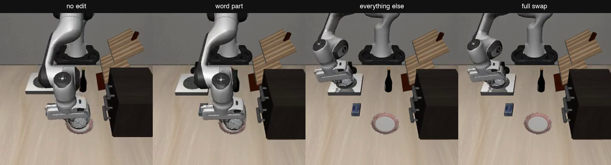
One example: the robot really moves
Same moment, all told “plate”. Left to right: no edit · readable part only → both still go to the plate. Hidden part only · whole change → both carry the bowl to the stove.
One clear case, picked to illustrate the counts on the previous slide.
Notes:
Here’s one of the 19 moments, all four runs told plate. On the left, no edit: the bowl goes to the plate. Next, I paste only the part the lens can read, the model now reads stove, but the bowl still goes to the plate. Third, I paste only the part the lens can’t read: the robot turns and puts the bowl on the stove. Last, the whole change: also the stove. I picked this one because it’s clear, so it illustrates the counts, it isn’t evidence by itself.

Slide 8
Takeaway
You can read the robot’s goal, and you can steer the robot, but the part you can read isn’t the part that steers it.
Limits today
Practice runs, not the final held-out test
Starts after the bowl is picked up, when the goal may already be set
One model, one layer, one task pair
Notes:
To sum up: you can read the robot’s goal inside the model, and you can steer the robot by editing its internal state, but the part you can read isn’t the part that steers it. The G0.5 paper saw the same split and linked it to its memory layers; this model has none and shows it anyway, with the robot actually moving. The limits: these are practice runs, not the final held-out test; they start after the bowl is picked up, when the goal may already be decided; and it’s one model, one layer and one task pair. The next slide is what I’ll look at next.

Slide 9
Vision: what I’ll inspect next
Goal: a simple test for whether what we read inside a robot model is what actually drives it, before anyone trusts that reading to watch over a robot.
1 · Make it solid
2 · Open the hidden part
3 · Beyond one robot
Is the split real?
If not the word, what carries the goal?
When does reading = steering?
More moments, held out from tuning
Earlier moments, before the bowl is picked up
Move the plate and stove: does the bowl follow the target?
Other goals: which object, not just where
Other models: with memory layers, and bigger ones
Package it as a check anyone can run
Read it with the J-lens too, not just the logit lens
Check if it points toward the arm’s moves instead of words
Follow it across layers and spots
Notes:
Here’s where I want to take this. The long-term goal is a simple test for whether what we can read inside a robot model is what actually drives it. That matters because people want to use these readings to watch over robots, and my result says a reading can look right while the robot does something else. Step one is making sure the split is real: more moments that I didn’t use for tuning, earlier moments before the bowl is picked up, and moving the plate and stove to check the bowl follows the target, not just a direction. Step two is opening up the hidden part: if the goal isn’t carried by the word, what carries it? I’ll read it with the J-lens as well as the logit lens, check whether it lines up with the arm’s moves instead of words, and follow it across layers and positions. Step three is going beyond one robot: other kinds of goals, like which object to pick, and other models, including ones with memory layers like G0.5 and bigger ones, so I can say when reading equals steering and when it doesn’t, and turn that into a check anyone can run.

Slide 10
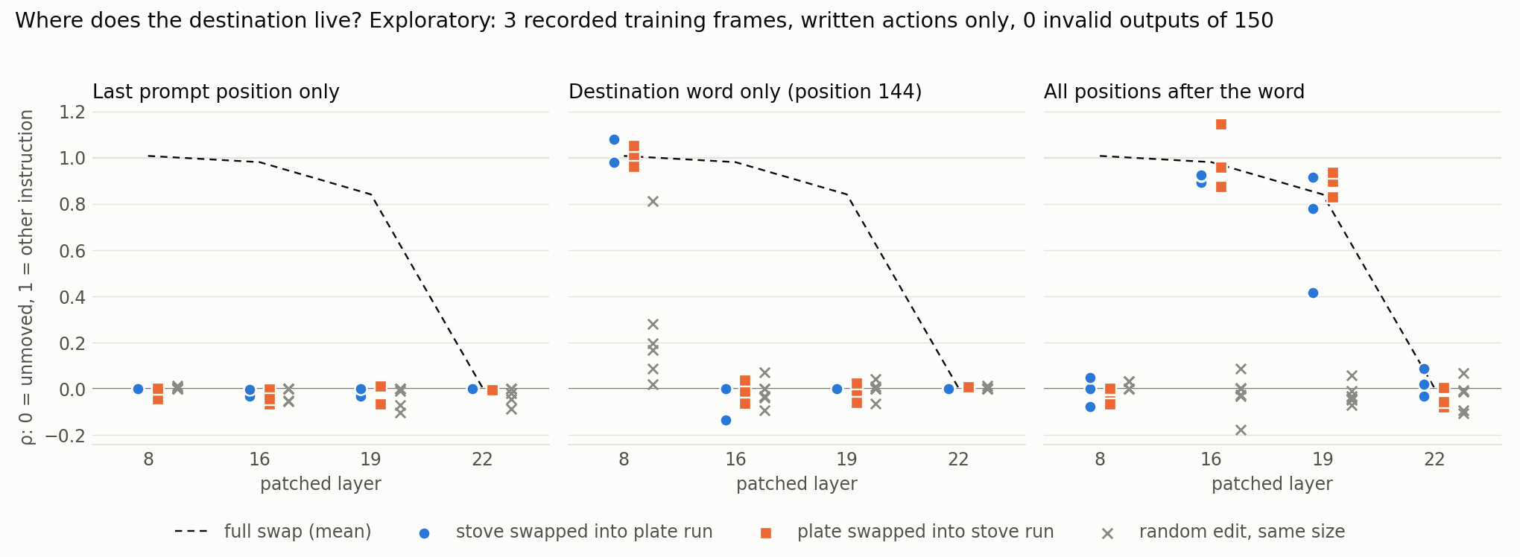
Where the goal lives inside the model
Early result · 3 test pictures
Paste a note from the “stove” run into the “plate” run, let the model finish, and score its typed arm moves (not the lens): 1 = same as the stove moves, 0 = unchanged. Layer 8: the word itself carries the goal. Layers 16–19: the words after it. Layer 22: too late. The last spot never steers.
Notes:
I run the model twice, told plate and told stove, then paste notes from the stove run into the plate run at one layer and see whether the typed arm moves switch to the stove. One means fully switched, zero means nothing happened. The gray crosses are random edits of the same size, the control, and they stay near zero. The goal starts on the word itself at layer 8, moves into the words after it by layers 16 to 19, and by layer 22 the model has already taken it. And the very last spot, where we can read the goal, never controls the arm. Early result: three pictures the robot saw during training, typed actions only.

Slide 11
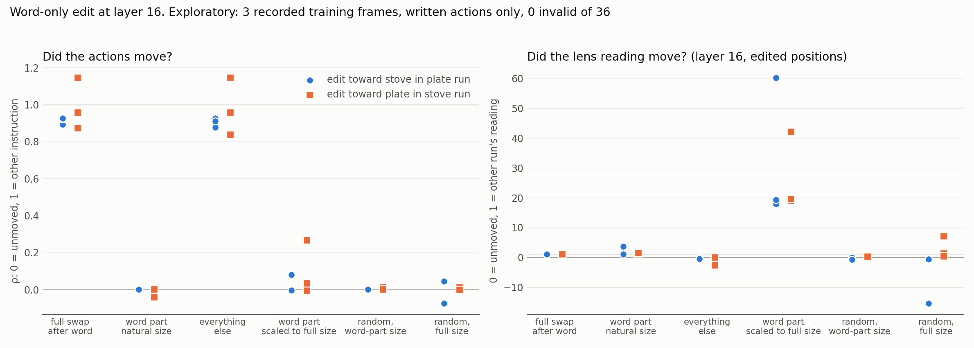
Readable is not controlling (layer 16)
Early result · 3 test pictures
Pasting only the word part changes what the lens reads, but the arm doesn’t move, even at 21× size. The part that steers the arm is the part you can’t read.
Notes:
This is the main question. I split the stove note into two parts: the word part, which is what the lens reads as stove, and everything else. Pasting the whole note switches the robot, about 0.95. Pasting only the word part changes the reading, the lens now says stove, but the robot doesn’t move at all. Even making it 21 times bigger barely moves it. Pasting everything else switches the robot. Random edits do nothing. So you can change what the model reads as the goal and the robot ignores it. G0.5 found the same split and thought it might come from its recurrent memory layers; this model has none and shows it anyway. Early result: three pictures the robot saw during training, one layer, typed actions only.

